Slide 1
Flame Detector
Presented By:
Chandana R S
Anusha
Nayana U S
Divya H C

Slide 2
INTRODUCTION:
Flame Sensors, Smoke Sensors, Fire Alarms etc. are part of a safety equipment that help us in keeping our homes, offices and stores safe from fire accidents.
Almost all modern houses, apartments, malls, cinema halls, theatres, office buildings and shops are equipped with such safety equipment and it is mandatory in some regions to fire safety devices.
Commercial fire safety devices are advanced with a lot of complex circuitry. If you want to implement a DIY Fire or Flame detection application, then this project might be helpful.

Slide 3
Components Required:
Arduino Mega
IR Flame Sensor
LED bulb
Buzzer
Jumper wires
Node MCU 1.0

Slide 4
A Brief Note on Flame Sensor:
A Flame Sensor is a device that can be used to detect presence of a fire source or any other bright light sources. There are several ways to implement a Flame Sensor but the module used in this project is an Infrared Radiation Sensitive Sensor.
This particular flame sensor is based on YG1006 NPN Photo Transistor. The black object at the front of the module is this Photo Transistor.
The YG1006 Photo Transistor looks like a black LED but it is a three terminal NPN Transistor, where the long lead is the Emitter and the shorter one is the collector (there is no base terminal as the light it detects will enable the flow of current).
This photo transistor is coated with black epoxy, making it sensitive to Infrared radiations and this particular Photo Transistor (YG1006) is sensitive to Infrared Radiation in the wavelength range of 760nm to 1100nm.

Slide 5
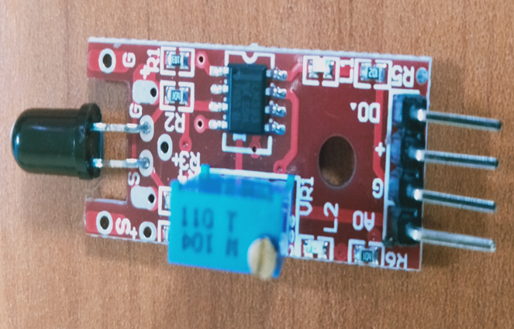
Using this particular type of Flame Sensor, you can detect Infrared Light up to a distance of 100cm within its 60 degrees of detection angle.
There are two types of implementations of Flame Sensors using YG1006 Photo Transistor: one is with both Analog Output and Digital Output while the other is with only the Digital Output.

Slide 6
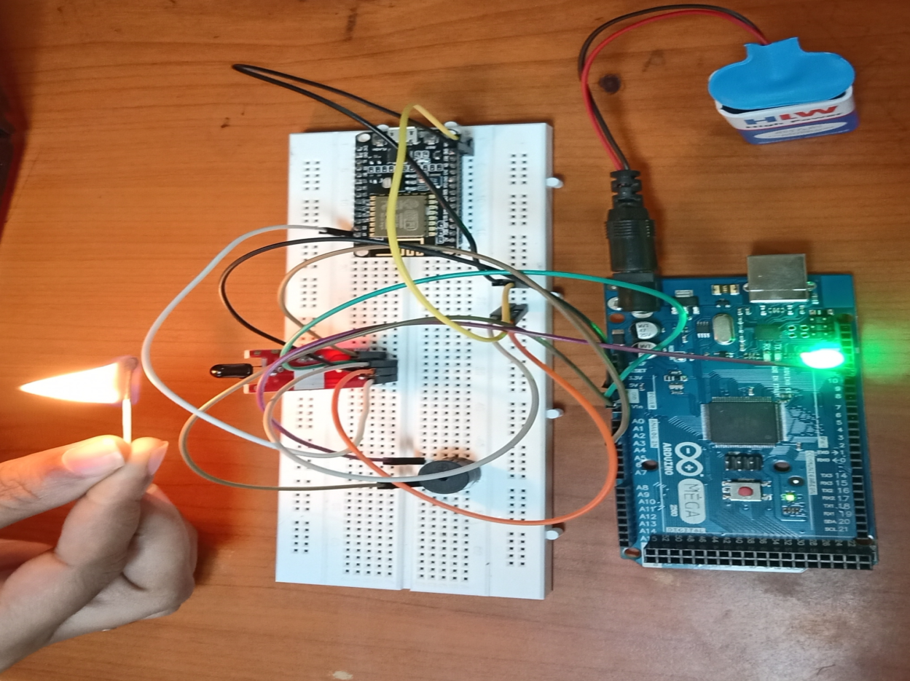
Project Setup:

Slide 7
THANK YOU

